Slide 1
SVM PROJECT ON PREDICTING PULSAR STAR
Prepared by Farooq Shaikh
Under The Guidance of
Rithik Raj
Imarticus Learning, Thane

Slide 2
Introduction :
Pulsar stars are a fascinating and enigmatic class of astronomical objects.
They are highly magnetized, rapidly rotating neutron stars that emit beams of electromagnetic radiation.
The dataset which we are going to work on is "Predicting Pulsar Star" , available on Kaggle, which offers a unique opportunity to delve into the world of pulsar stars through data-driven exploration and predictive modeling.
This dataset is a product of extensive observations and data collection in the field of radio astronomy.

Slide 3
Dataset :
The dataset consists of various features derived from radio signal data, which are crucial for detecting the presence of pulsar stars.
These features include parameters related to the integrated profile and the DM-SNR curve, among others.
In essence, the dataset encapsulates valuable characteristics of radio signals that can be analyzed to determine whether a celestial object is a pulsar star or not.

Slide 4
Objective :
The primary objective of this project is to predict the existence of pulsar stars based on the provided features.
By employing machine learning techniques, particularly Support Vector Machines (SVM) and Naïve Bayes Classificarion algorithms, we aim to develop predictive models that can accurately classify pulsar stars from other celestial objects.
This project has the potential to contribute to the field of astronomy by improving the efficiency of pulsar star identification.

Slide 5
Literature Survey :
During the execution of solution, we found following websites relevant to our proposed system :
https://www.kaggle.com/datasets/jagruthiadapa/predicting-pulsar-star
https://satyam5120.medium.com/predicting-a-pulsar-star-using-different-machine-learning-algorithms-d22ee8fc71b4
https://www.kaggle.com/code/ayedbochra/support-vector-machine-data-processing-analysis
https://towardsdatascience.com/predicting-pulsar-stars-an-imbalanced-classification-task-comparing-bootstrap-resampling-to-smote-8cfbe037b807

Slide 6
Data Exploration
Data exploration is an important step in any machine learning project, including one for Support Vector Machine(SVM).
It helps you understand your dataset, identify patterns, and prepare the data for modeling.
Data exploration steps includes importing the libraries, loading the dataset and initial data examination.

Slide 7
Data Preprocessing
Data preprocessing is a crucial step in preparing your SVM model.
It involves cleaning, transforming, and encoding the data so that it can be used effectively for training and testing your SVM model.
This step includes :
Handling missing values: Depending on the dataset, imputing missing values using mean, median, or other methods.
Normalize or scale features, to ensure that all features have a similar scale.
Converting categorical variables into numerical representations.

Slide 8
Exploratory Data Analysis (EDA) :
We have performed Exploratory Data Analysis (EDA) to understand the relationships between variables, such as how features vary with the target variable.
Created visualizations like pair plots, bar plot, histogram, box plot, scatter plot, violin plot, strip plot, rel plot, kde plot, ecdf plot, rug plot, heatmaps, and correlation matrices to explore feature interactions.

Slide 9
Model Building
We have created an SVM model using libraries like scikit-learn.
Configured the SVM model with a kernel function (e.g., ‘linear’, ‘rbf’, ‘polynomial’, ‘sigmoid’) and set hyperparameters (e.g., C ).
The kernel parameter defines the kernel function to use. You can choose 'linear', 'rbf' (Radial Basis Function), or 'poly' (polynomial).
The C parameter is the regularization parameter, controlling the trade-off between maximizing the margin and minimizing classification errors.

Slide 10
Model Evaluation
In this project, we have assessed the performance of our SVM model using appropriate classification metrics such as accuracy, classification report, confusion matrix and the roc curve.
Accuracy is the proportion of correct predictions over total predictions.
A classification report provides a summary of various metrics that describe the model's performance, such as precision, recall, and F1-score.
A confusion matrix is a table that is used to define the performance of a classification algorithm.
An ROC curve (receiver operating characteristic curve) is a graph showing the performance of a classification model at all classification thresholds.

Slide 11
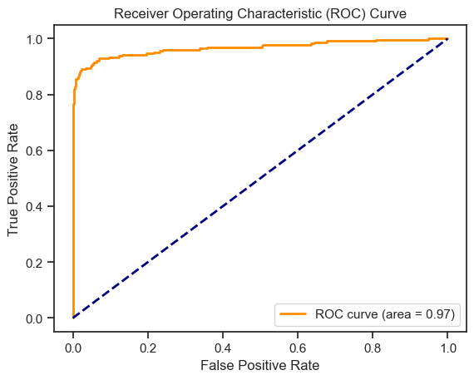
ROC Curve

Slide 12
Conclusion
Through data preprocessing and SVM model construction, we've enabled the accurate classification of pulsar stars.
Evaluated the SVM model's performance using appropriate metrics such as accuracy, classification report, confusion matrix and the roc curve.
The accuracy of the model came out be 97.96% before tuning, and after tuning the score has increased to 98.12%.
In conclusion, the SVM model has proven its ability in handling this classification task, delivering strong predictive performance.

Slide 13
References
https://www.kaggle.com/datasets/jagruthiadapa/predicting-pulsar-star
https://satyam5120.medium.com/predicting-a-pulsar-star-using-different-machine-learning-algorithms-d22ee8fc71b4
https://www.kaggle.com/code/ayedbochra/support-vector-machine-data-processing-analysis
https://towardsdatascience.com/predicting-pulsar-stars-an-imbalanced-classification-task-comparing-bootstrap-resampling-to-smote-8cfbe037b807

Slide 14
Thank You

